Slide 1
Smart Guide: A smart campus guide using BLE based indoor localization
Presentation By:
Rida Mahmood (2016-CE-54)
Tooba Naseer (2016-CE-72)
Rabeya Hamood (2016-CE-81)
Ayesha Jabbar (2016-CS-159)
Supervised By:
Dr Sheikh Faisal Rasheed

Slide 2
INTRODUCTION
Predict room level location using BLE beacons.
RSSI fingerprinting technique.
Information of current and its nearby locations on user’s mobile app.
To provide guided tour of the indoor building (CE Dept of UET).

Slide 3
PROBLEM
SOLUTION
Whenever a visitor goes to university campus or visits a new place, he does not know about the specifications of that area i.e. what happens in that specific room or what courses have been taught in a particular and its nearby labs.
So, we are developing a system which assists them in determining the textual and pictorial information of a particular area and its nearby locations. For this purpose, we first find the indoor location of a user by using BLE beacons and FP values, and then provide information to him automatically on his android application.

Slide 4
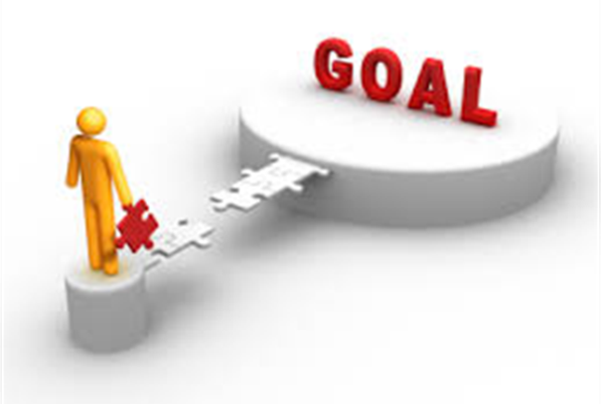
GOAL
Our goal is to provide ease and guidance to users regarding current and nearby locations automatically via installed application on device by estimating his indoor location. The guidance involves the textual and pictorial information.

Slide 5
Objectives
To find the indoor location of the user at room level and provide location information on his/her Android application. To monitor and provide guidelines to the user about his/her indoor location through his/her BLE enable Android application.
Implement a system that takes into account the demands of university campus exploration. This project leads to visitors of any organization or store to save their time and effort by providing them textual and pictorial information related to organization or store.

Slide 6
Scope
In this project, data capturing application runs on mobile device and will capture BLE RSSI ﬁngerprints.
The ﬁngerprints collected at the initial stage will be processed and used to train suitable machine learning model,
After training the model, based on the room prediction relevant information of nearby rooms, facilities and personnel available will be prepared to be displayed to user at run time
The user will be guided to install our Android app on their phone, their mobile device will capture BLE ﬁngerprint and the ﬁngerprint will be sent to backend server where our trained model will predict their current location inside building .
The relevant information shown on user mobile device providing guided tour.
The placement of Bluetooth low energy beacons will be held in CE dept at UET Lahore.

Slide 7
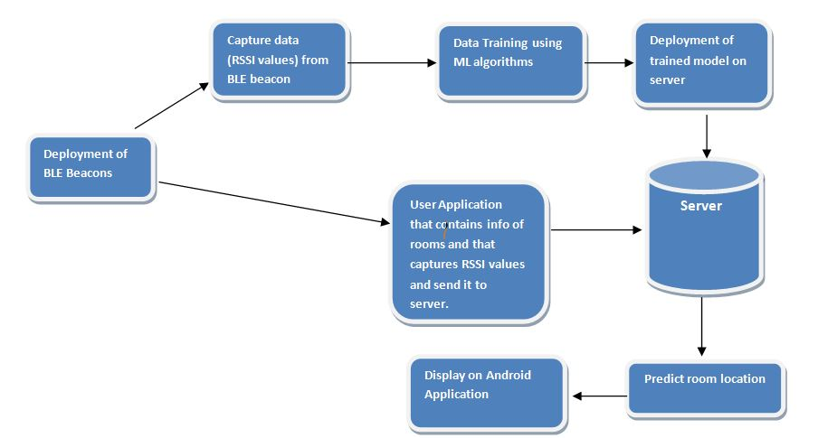
PROPOSED SYSTEM

Slide 8
DESCRIPTION
It navigates the user location
It also give the user’s nearby location
It provides information of the current location of user i.e. the room’s pictures and in textual description it will tell about the office hours or if it is a lab then how many teachers are teaching in that lab and the schedule.
User can see that if his nearby place is room or lab. It will provide the room number and pictures.
Most of us don’t use guide boards because it is time consuming. This app will navigate you to your required labs.

Slide 9
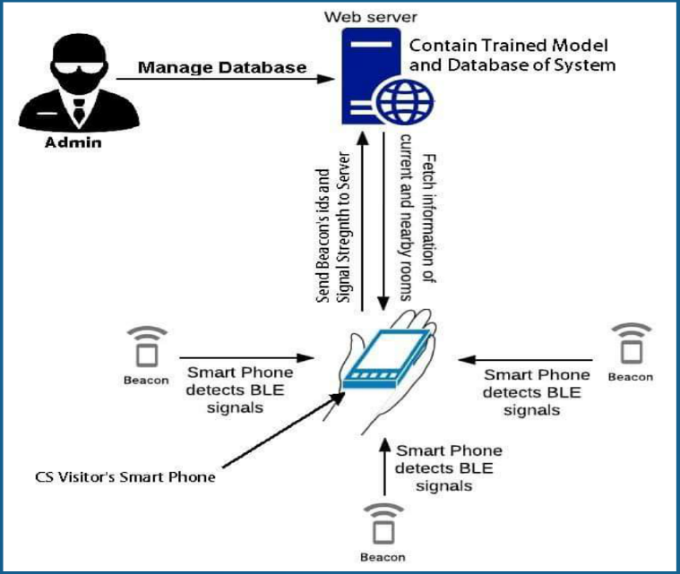
ARCHITECTURE DESIGN

Slide 10
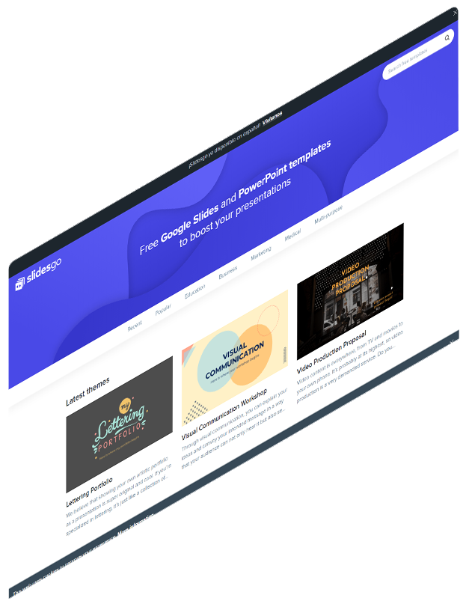
IMPLEMENTATION
Actually, our proposed system has three Android applications.
Data Capturing App
Admin App
User App
There is another module which is used in our project that is Machine Learning

Slide 11
IMPLEMENTATION
Data Capturing Application:
Scanning of nearby BLE devices and capture RSSI fingerprints. Generate .csv files of captured data. Allow user to generate these files according to no of iterations and delay time provided by user.
Admin Android Application:
This Admin Application allows admin to Add/Edit/Del information related to locations. This information is stored in database and the database is connected with admin application.
User Android Application:
This User Application provides guidance to the users. It displays the location of user and shows all information related to current room and nearby rooms. Also update the location of the user after some time interval.

Slide 12

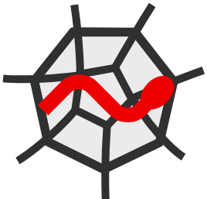


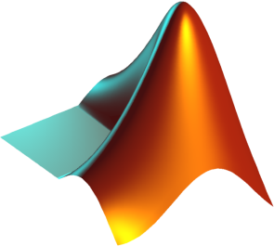
TOOLS FOR IMPLEMENTATION
1. Android Studio 3.5 or above with JAVA development for making android applications
2, Python IDE(Spyder) for the training of machine learning model
3. MATLAB for the compilation of BLE beacons dataset
4. PHP scripts used to access database by Android studio
5. MySQL used for online database.

Slide 13
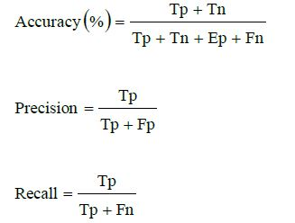
Methodology with Mathematics Equation
BLE- based Fingerprinting Technique
Machine Learning
Parameters Tuning for k-NN, ANN and Random Forest
Training by using these three algorithms
Detail Analysis
Selected Approach: ANN
Machine Learning Phases:
Dataset Pre-Processing
Training Phase and Testing
Phase
Performance Evaluation Metrics

Slide 14
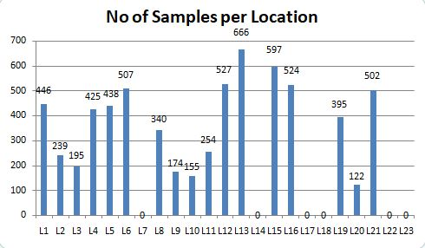
Results
Number of collected samples per location shown here:

Slide 15
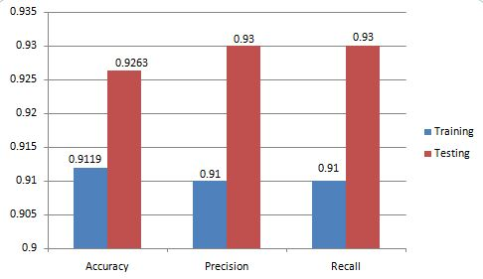
Results
ANN outperforms KNN and random forest. Here is the ANN performance graph:

Slide 16
Discussion
Here is the confusion matrix for ANN.
Our results shows that ANN gives better performance as compared to others because usually deep learning performs better on this type of data.
We use the fingerprinting technique that collects BLE beacons fingerprints and apply ML algorithm on it.
Our system predicts the indoor location with 92.63% accuracy which is better than existing systems that predicts indoor locations with older technologies.
Hence fingerprinting approach used with BLE beacons is the most suitable approach for indoor localization

Slide 17
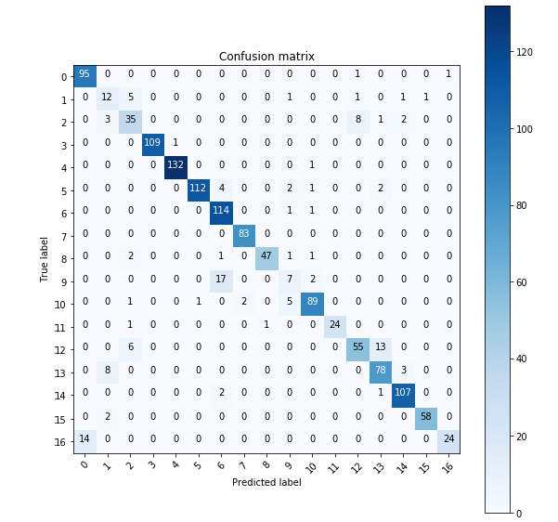
Discussion

Slide 18
Conclusion & Future Work
We developed an Android application for our CE department, UET Lahore. But in future we will make this application for whole university.
In airports, where we have to give information of waiting, luggage, canteen areas to the passengers through this application.
In hospitals, where a patient or his partner wants to know about emergency, integrated care units, medical testing areas and much more. This kind of application will lead them to their destination.
We can implement this system into the shopping malls, so that users finds products and things easily. Due to this shopping mall also gets huge benefit in the terms of sales and profit.
We can also aware system users to find the place using indoor map of building where they want to go, this will lead to possible extensibility of our project in future.

Slide 19
THANKS!
Do you have any questions?

